Slide 1
Classification : Decision Tree
Decision Trees are a popular supervised machine learning algorithm used for both classification and regression tasks. They work by learning simple decision rules inferred from the data features to predict a target label.
A Decision Tree is structured as a tree where each node represents a decision based on a feature of the data, and each branch represents an outcome of that decision.
The root node is the topmost node, representing the first decision.
The internal nodes are decision points, splitting based on feature values.
Leaf nodes are the endpoints representing the final prediction or output.

Slide 2
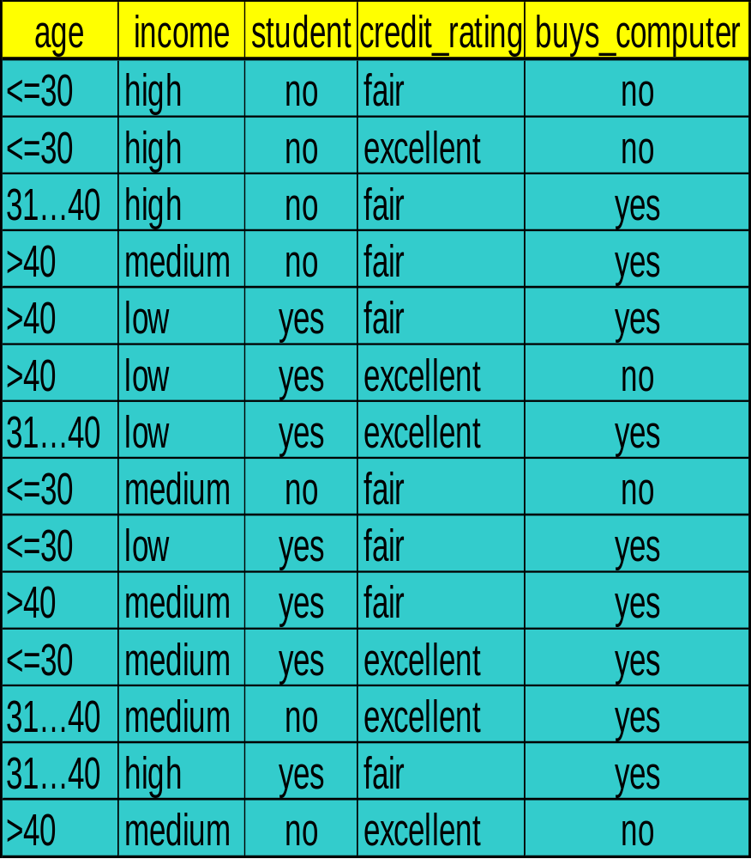
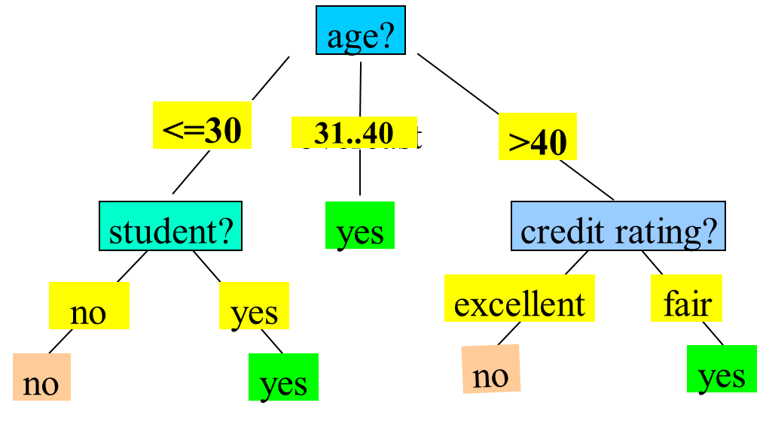
Classification : Decision Tree

Slide 3
Classification : Decision Tree
Basic algorithm (a greedy algorithm):
Tree is constructed in a top-down recursive divide-and-conquer manner
At start, all the training examples are at the root
Attributes are categorical (if continuous-valued, they are discretized in advance)
Examples are partitioned recursively based on selected attributes
Test attributes are selected based on a heuristic or statistical measure (e.g., information gain)

Slide 4
Classification : Decision Tree
ID3 (Iterative Dichotomiser 3) is a classic algorithm used to construct a Decision Tree, primarily for classification tasks. It was developed by Ross Quinlan and serves as one of the earliest algorithms in Decision Tree-based models.
D3 aims to create a Decision Tree by selecting the most significant feature at each step that best separates the data for classification.
It does this by using information gain (based on entropy) as the criterion to determine the best feature to split on.
Conditions for stopping partitioning:
All records have the same target class (pure leaf node).
No more features to split on (terminate as a leaf node).
Reaching a specified maximum depth or minimum samples threshold to prevent overfitting.

Slide 5
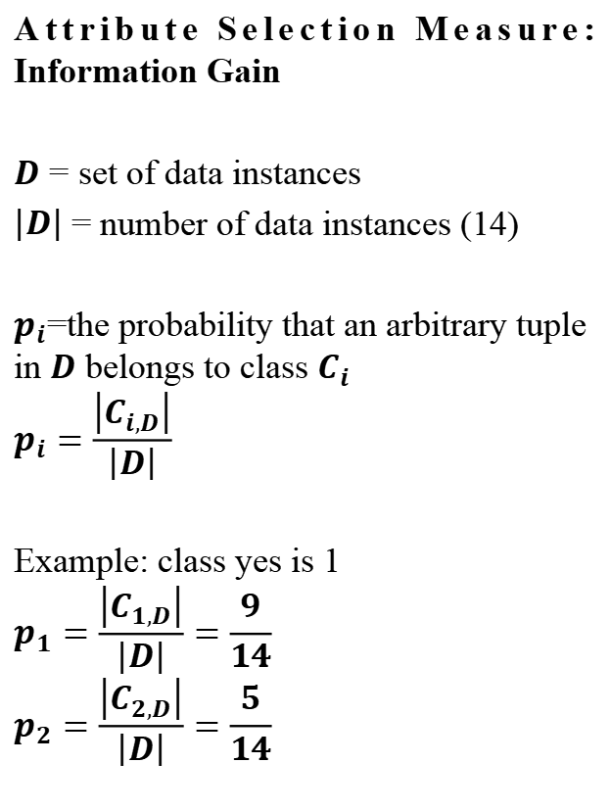
Classification : Decision Tree
Attribute Selection Measure: Information Gain
$D$ = set of data instances
$\left|D\right|$ = number of data instances (14)
$p_{i}$=the probability that an arbitrary tuple in $D$ belongs to class $C_{i}$
$$p_{i}=\frac{\left|C_{i,D}\right|}{\left|D\right|}$$
Example: class yes is 1
$$p_{1}=\frac{\left|C_{1,D}\right|}{\left|D\right|}=\frac{9}{14}$$
$$p_{2}=\frac{\left|C_{2,D}\right|}{\left|D\right|}=\frac{5}{14}$$

Slide 6
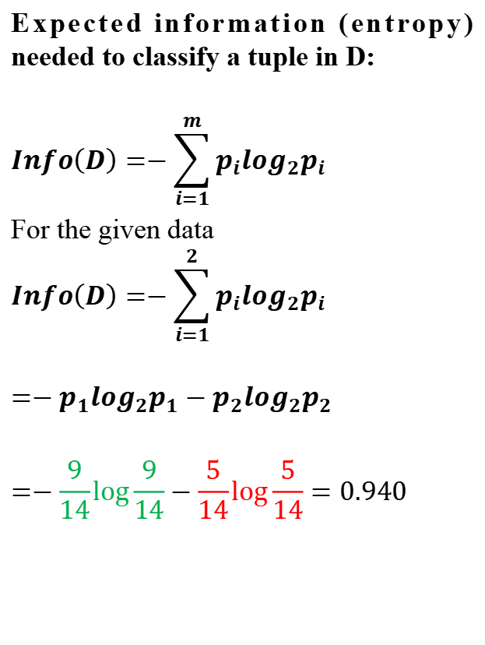
Classification : Decision Tree
Expected information (entropy) needed to classify a tuple in D:
$$Info\left(D\right)=−\sum_{i=1}^{m}{p_{i}\log_{2}p_{i}}$$
For the given data
$$Info\left(D\right)=−\sum_{i=1}^{2}{p_{i}\log_{2}p_{i}}$$
$${=−p}_{1}\log_{2}p_{1}−p_{2}\log_{2}p_{2}$$
$$=−\frac{9}{14}\log{\frac{9}{14}}−\frac{5}{14}\log{\frac{5}{14}}=0.940$$

Slide 7
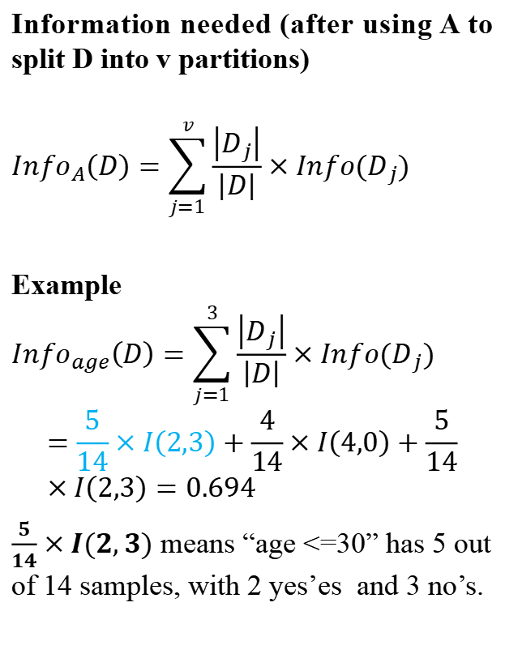
Classification : Decision Tree
Information needed (after using A to split D into v partitions)
$${Info}_{A}\left(D\right)=\sum_{j=1}^{v}{\frac{\left|D_{j}\right|}{\left|D\right|}}×Info(D_{j})$$
Example
$${Info}_{age}\left(D\right)=\sum_{j=1}^{3}{\frac{\left|D_{j}\right|}{\left|D\right|}}×Info(D_{j})$$
$$=\frac{5}{14}×I\left(2,3\right)+\frac{4}{14}×I\left(4,0\right)+\frac{5}{14}×I\left(2,3\right)=0.694$$
$\frac{5}{14}×I(2,3)$ means “age <=30” has 5 out of 14 samples, with 2 yes’es and 3 no’s.

Slide 8
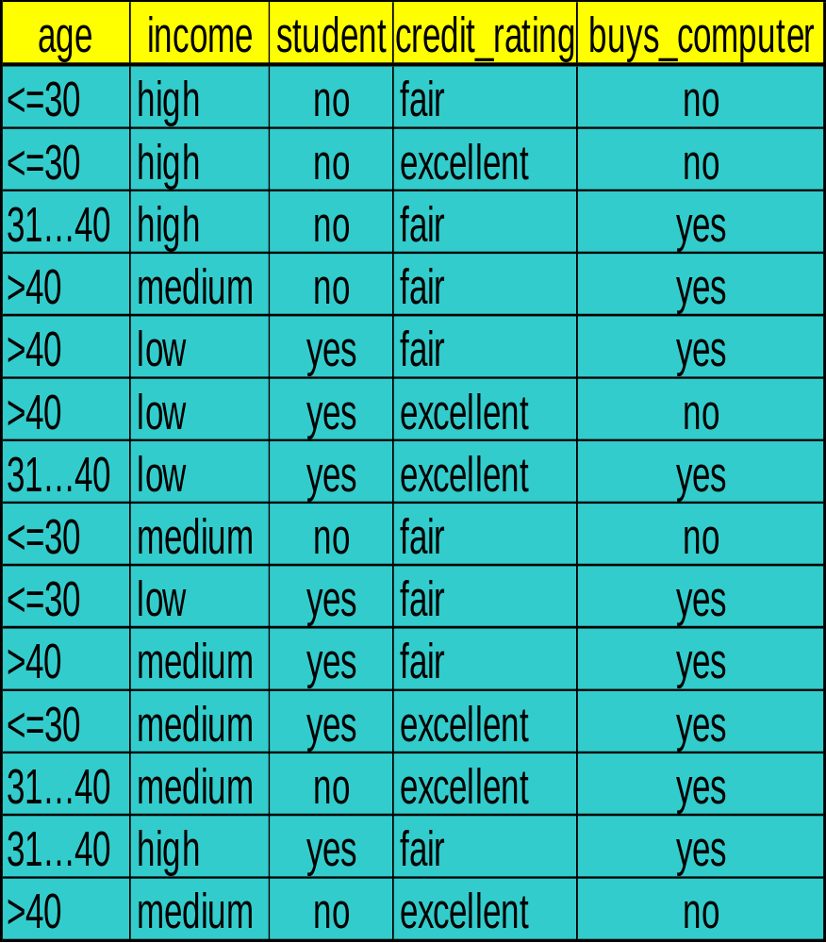
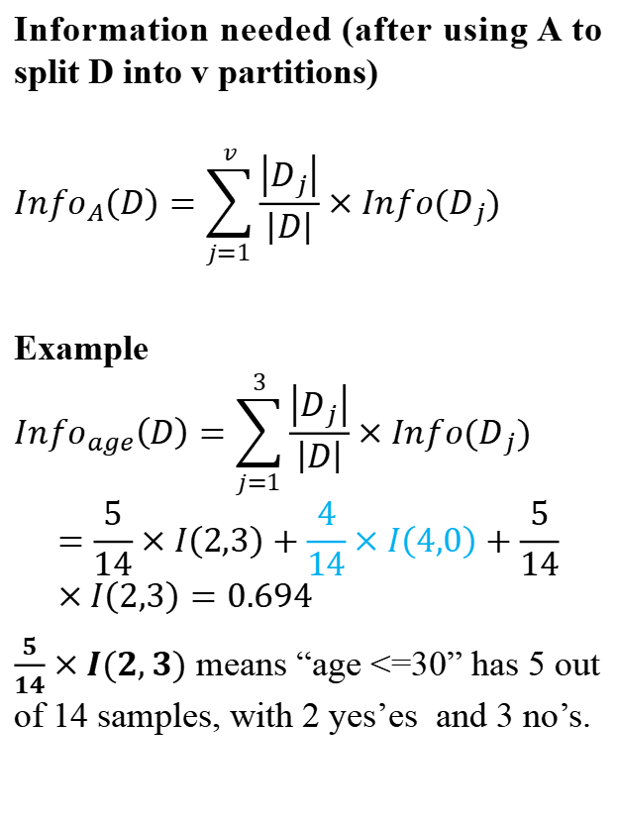
Classification : Decision Tree
Information needed (after using A to split D into v partitions)
$${Info}_{A}\left(D\right)=\sum_{j=1}^{v}{\frac{\left|D_{j}\right|}{\left|D\right|}}×Info(D_{j})$$
Example
$${Info}_{age}\left(D\right)=\sum_{j=1}^{3}{\frac{\left|D_{j}\right|}{\left|D\right|}}×Info(D_{j})$$
$$=\frac{5}{14}×I\left(2,3\right)+\frac{4}{14}×I\left(4,0\right)+\frac{5}{14}×I\left(2,3\right)=0.694$$
$\frac{5}{14}×I(2,3)$ means “age <=30” has 5 out of 14 samples, with 2 yes’es and 3 no’s.

Slide 9
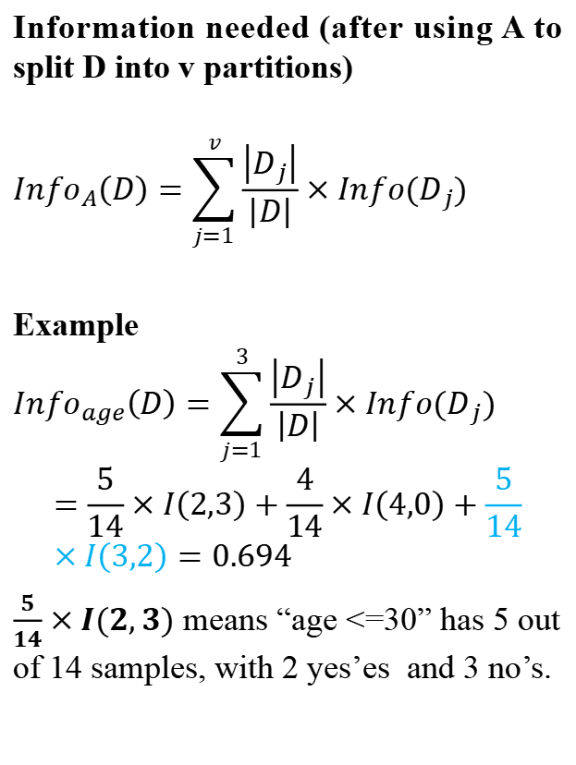
Classification : Decision Tree
Information needed (after using A to split D into v partitions)
$${Info}_{A}\left(D\right)=\sum_{j=1}^{v}{\frac{\left|D_{j}\right|}{\left|D\right|}}×Info(D_{j})$$
Example
$${Info}_{age}\left(D\right)=\sum_{j=1}^{3}{\frac{\left|D_{j}\right|}{\left|D\right|}}×Info(D_{j})$$
$$=\frac{5}{14}×I\left(2,3\right)+\frac{4}{14}×I\left(4,0\right)+\frac{5}{14}×I\left(3,2\right)=0.694$$
$\frac{5}{14}×I(2,3)$ means “age <=30” has 5 out of 14 samples, with 2 yes’es and 3 no’s.

Slide 10
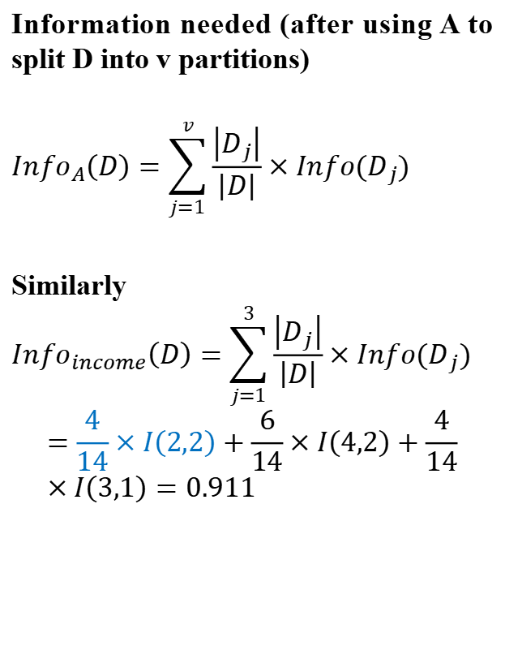
Classification : Decision Tree
Information needed (after using A to split D into v partitions)
$${Info}_{A}\left(D\right)=\sum_{j=1}^{v}{\frac{\left|D_{j}\right|}{\left|D\right|}}×Info(D_{j})$$
Similarly
$${Info}_{income}\left(D\right)=\sum_{j=1}^{3}{\frac{\left|D_{j}\right|}{\left|D\right|}}×Info(D_{j})$$
$$=\frac{4}{14}×I\left(2,2\right)+\frac{6}{14}×I\left(4,2\right)+\frac{4}{14}×I\left(3,1\right)=0.911$$

Slide 11
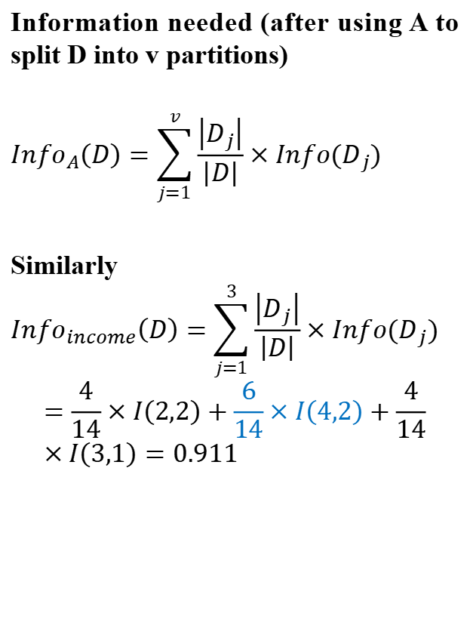
Classification : Decision Tree
Information needed (after using A to split D into v partitions)
$${Info}_{A}\left(D\right)=\sum_{j=1}^{v}{\frac{\left|D_{j}\right|}{\left|D\right|}}×Info(D_{j})$$
Similarly
$${Info}_{income}\left(D\right)=\sum_{j=1}^{3}{\frac{\left|D_{j}\right|}{\left|D\right|}}×Info(D_{j})$$
$$=\frac{4}{14}×I\left(2,2\right)+\frac{6}{14}×I\left(4,2\right)+\frac{4}{14}×I\left(3,1\right)=0.911$$

Slide 12
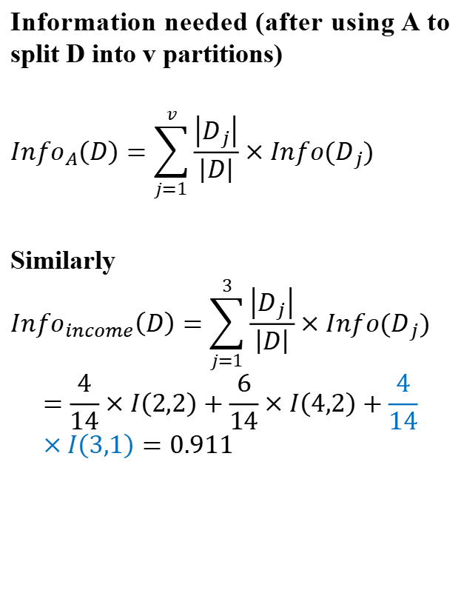
Classification : Decision Tree
Information needed (after using A to split D into v partitions)
$${Info}_{A}\left(D\right)=\sum_{j=1}^{v}{\frac{\left|D_{j}\right|}{\left|D\right|}}×Info(D_{j})$$
Similarly
$${Info}_{income}\left(D\right)=\sum_{j=1}^{3}{\frac{\left|D_{j}\right|}{\left|D\right|}}×Info(D_{j})$$
$$=\frac{4}{14}×I\left(2,2\right)+\frac{6}{14}×I\left(4,2\right)+\frac{4}{14}×I\left(3,1\right)=0.911$$

Slide 13
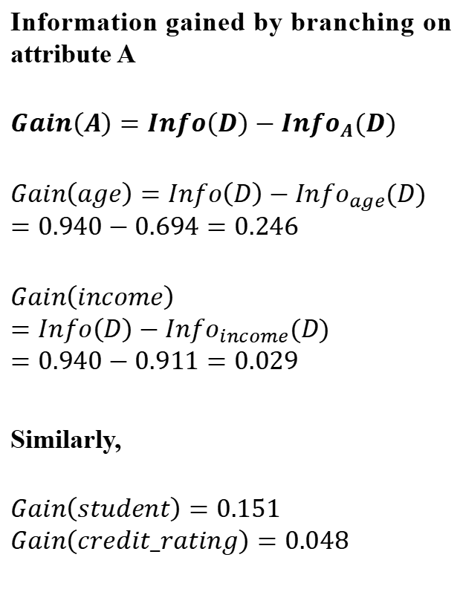
Classification : Decision Tree
Information gained by branching on attribute A
$$Gain\left(A\right)=Info\left(D\right)−{Info}_{A}(D)$$
$$Gain\left(age\right)=Info\left(D\right)−{Info}_{age}(D)$$
$$=0.940−0.694=0.246$$
$$Gain\left(income\right)=Info\left(D\right)−{Info}_{income}(D)$$
$$=0.940−0.911=0.029$$
Similarly,
$$Gain\left(student\right)=0.151$$
$$Gain\left(credit_rating\right)=0.048$$

Slide 14
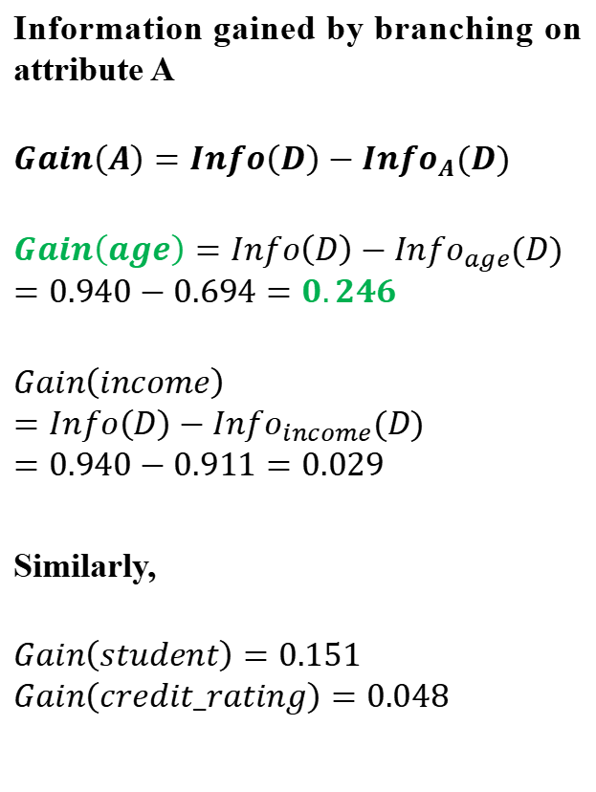
Classification : Decision Tree
Information gained by branching on attribute A
$$Gain\left(A\right)=Info\left(D\right)−{Info}_{A}(D)$$
$$Gain\left(age\right)=Info\left(D\right)−{Info}_{age}(D)$$
$$=0.940−0.694=0.246$$
$$Gain\left(income\right)=Info\left(D\right)−{Info}_{income}(D)$$
$$=0.940−0.911=0.029$$
Similarly,
$$Gain\left(student\right)=0.151$$
$$Gain\left(credit_rating\right)=0.048$$

Slide 15
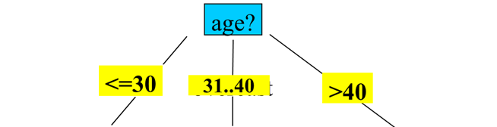
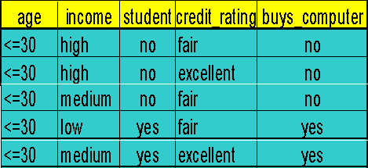
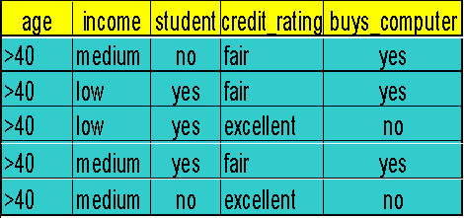
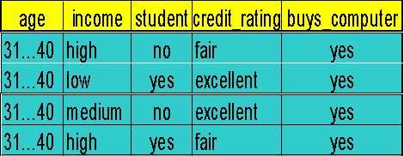
Classification : Decision Tree
Next, repeat the same process with the other nodes with smaller dataset.
So, the first split is on the age attribute

Slide 16
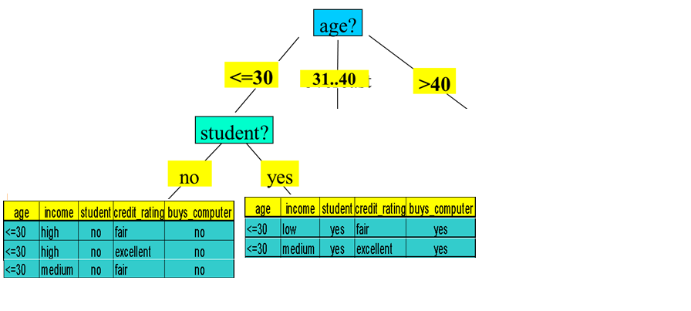
Classification : Decision Tree
Next split is on student at node <=30
All are yes
So, no further split here
All are no
So, no further split here

Slide 17
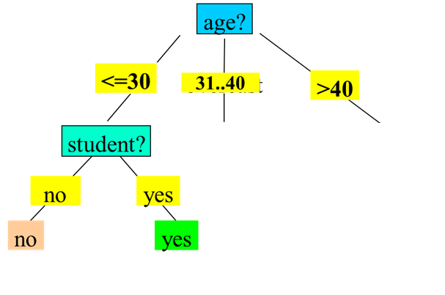
Classification : Decision Tree
No split is required at node 31..40
All are yes
So, no further split here

Slide 18
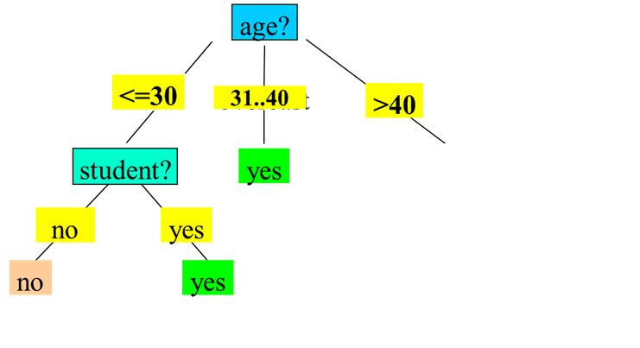
Classification : Decision Tree

Slide 19
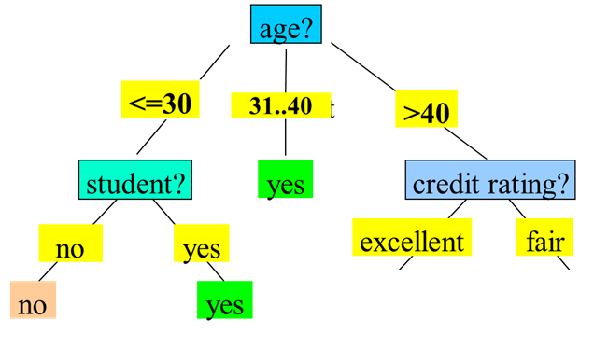

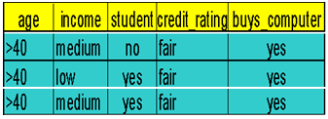
Classification : Decision Tree
Next split is on credit_rating at node >40

Slide 20
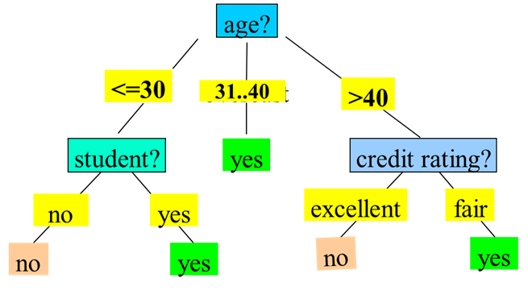
Classification : Decision Tree

Slide 21
Classification : Decision Tree
Classify a new instance
(age: <=30, income: low, student: yes, credit_rating: fair) = buys_computer?

Slide 22
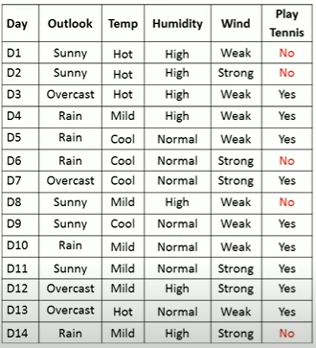
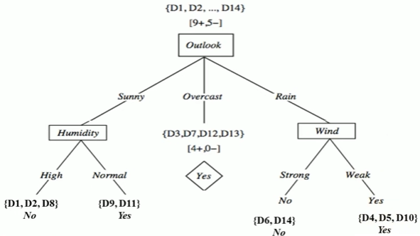
Classification : Decision Tree
Exercise

Slide 23
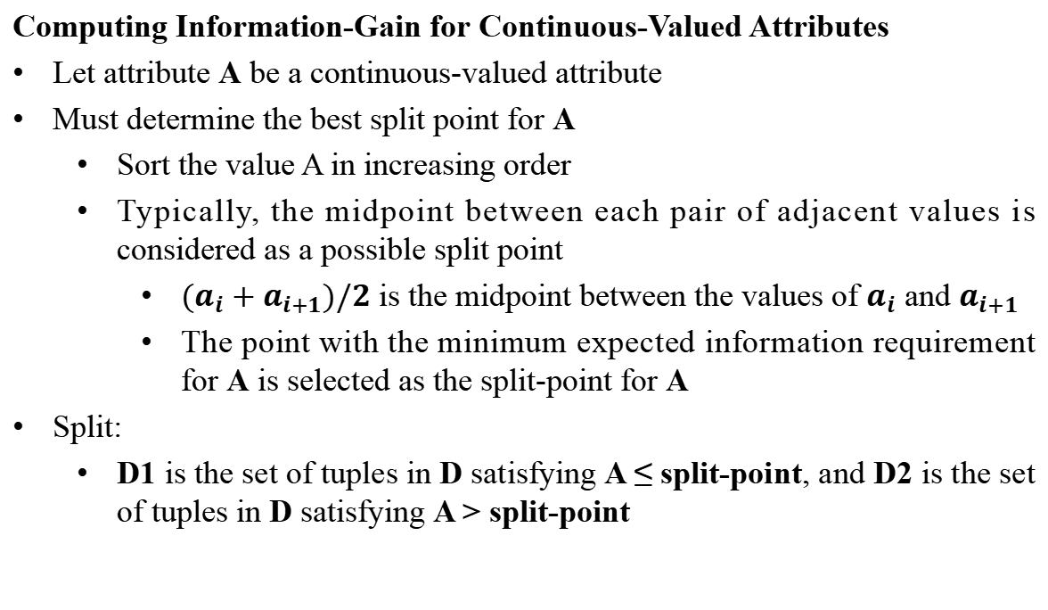
Classification : Decision Tree
Computing Information-Gain for Continuous-Valued Attributes
Let attribute A be a continuous-valued attribute
Must determine the best split point for A
  Sort the value A in increasing order
  Typically, the midpoint between each pair of adjacent values is considered as a possible split point
    ${(a}_{i}+a_{i+1})/2$ is the midpoint between the values of $a_{i}$ and $a_{i+1}$
    The point with the minimum expected information requirement for A is selected as the split-point for A
Split:
  D1 is the set of tuples in D satisfying A ≤ split-point, and D2 is the set of tuples in D satisfying A > split-point

Slide 24
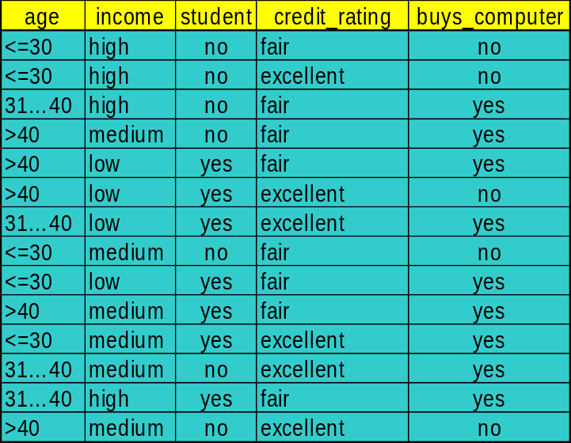
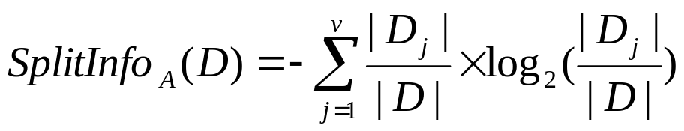
Classification : Decision Tree
Gain Ratio for Attribute Selection (C4.5)
Information gain measure is biased towards attributes with many values
C4.5 (a successor of ID3) uses gain ratio to overcome the problem (normalization to information gain)
  GainRatio(A) = Gain(A)/SplitInfo(A)
  gain_ratio(income) = 0.029/1.557 = 0.019

Slide 25
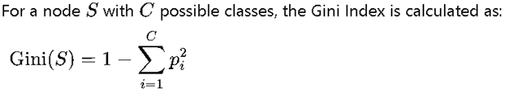
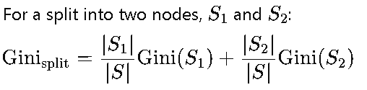
Classification : Decision Tree
Gini Index (CART-Classification and Regression Trees)
Information Gain and Gain Ratio can sometimes exhibit a bias toward features with many unique values. For example, if a feature has many unique categories, Information Gain might prefer it because it creates more distinct subsets.
To address this, Gain Ratio (an adaptation of Information Gain) is used in algorithms like C4.5 to counter this bias, but this additional step adds complexity.
Gini Index, on the other hand, is less sensitive to the number of categories in a feature, reducing the need for an additional adjustment like Gain Ratio.

Slide 26
Classification : Decision Tree
Overfitting in Decision Trees
Overfitting happens when a Decision Tree model becomes too complex, fitting too closely to the noise and specific details of the training data, resulting in poor generalization to new data.
Signs of Overfitting: A decision tree that overfits will often have a high accuracy on the training set but performs poorly on the test set.
Causes of Overfitting:
  Allowing the tree to grow too deep, with many nodes and branches.
  Having very specific branches (splits) that capture the peculiarities of the training data rather than general patterns.
Consequences: Overfitting leads to a lack of model generalization, where the model captures random fluctuations instead of meaningful trends.

Slide 27
Classification : Decision Tree
Pre-Pruning (Early Stopping):
This approach stops the tree from growing once it meets certain conditions, such as reaching a maximum depth, minimum number of samples per leaf, or minimum information gain threshold. This prevents the tree from developing complex branches that might lead to
Post-Pruning (Cost Complexity Pruning):
This technique first grows the tree to its full depth, then prunes back branches that provide minimal value. Post-pruning can be based on measures like cross-validation to determine the optimal structure that minimizes errors on new data.

Slide 28
Best Case for Decision Trees
Target Application: Medical Triage & Regulatory Compliance Decision trees map perfectly to human decision-making processes. In medical and legal environments, professionals require absolute transparency regarding why an algorithm made a specific recommendation.
Core Justifications:
Total Explainability: A decision tree provides a clear, human-readable flowchart. A doctor can easily verify the logic (e.g., IF fever > 39°C AND cough = yes THEN test for Flu).
Scale Invariance: Trees handle raw data effortlessly. Blood pressure can be measured in mmHg while temperature is in Celsius, and the tree's split criteria will remain entirely unaffected without needing normalization.
Natural Handling of Missing Data: Trees can naturally bypass missing patient records during inference by utilizing surrogate splits or isolating missing values into separate branches, without requiring complex data imputation.
Additional Examples:
Loan approval systems where banks are legally required to explain rejection reasons to applicants.
Fault diagnosis in mechanical engineering and HVAC systems.

Slide 29
Best Case for Decision Trees
Target Application: Customer Churn Prediction (CRM Systems) Customer relationship datasets contain a highly unstructured mix of categorical data (subscription tier, geographic location, device type) and continuous data (account age, total spent).
Core Justifications:
Mixed Data Native: Trees partition categorical and numerical data seamlessly. They do not require the massive expansion of columns caused by one-hot encoding categorical variables for linear models.
Automated Feature Selection: The Information Gain or Gini Impurity metrics automatically push the most critical predictors of churn to the top (root) of the tree, allowing business teams to instantly identify key behavioral drivers.
Non-Linear Conditional Logic: Trees effortlessly capture complex, interacting conditions (e.g., young customers churn if the price increases, but older customers churn only if customer service interactions are poor).
Additional Examples:
Predicting employee attrition based on HR data (salary, department, years of service).
Targeted marketing segmentation based on demographic profiles.

Slide 30
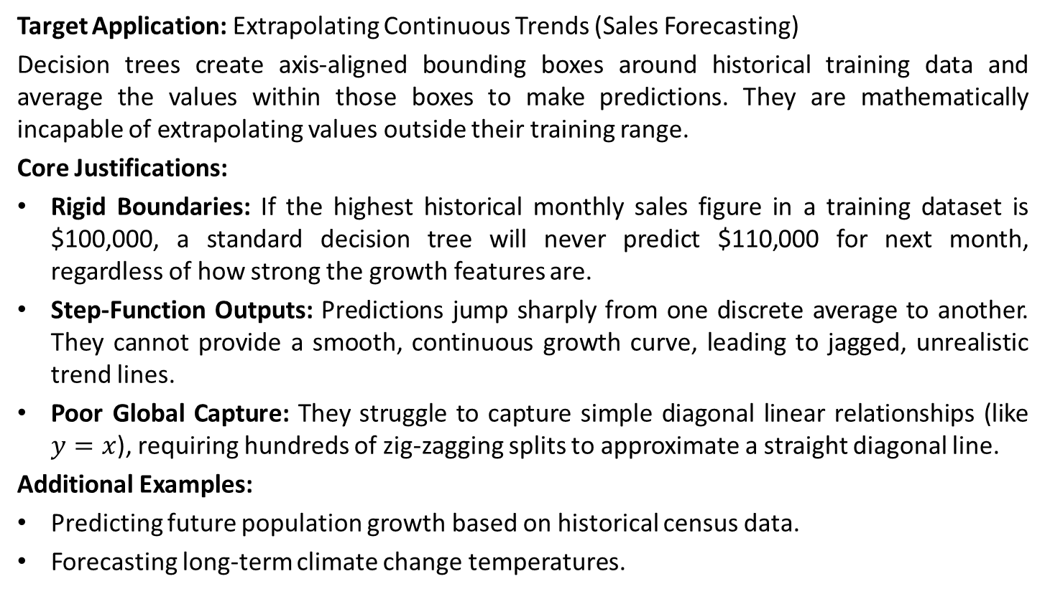
Worst Case for Decision Trees
Target Application: Extrapolating Continuous Trends (Sales Forecasting)
Decision trees create axis-aligned bounding boxes around historical training data and average the values within those boxes to make predictions. They are mathematically incapable of extrapolating values outside their training range.
Core Justifications:
Rigid Boundaries: If the highest historical monthly sales figure in a training dataset is $100,000, a standard decision tree will never predict $110,000 for next month, regardless of how strong the growth features are.
Step-Function Outputs: Predictions jump sharply from one discrete average to another. They cannot provide a smooth, continuous growth curve, leading to jagged, unrealistic trend lines.
Poor Global Capture: They struggle to capture simple diagonal linear relationships (like $y=x$), requiring hundreds of zig-zagging splits to approximate a straight diagonal line.
Additional Examples:
Predicting future population growth based on historical census data.
Forecasting long-term climate change temperatures.

Slide 31
Worst Case for Decision Trees
Target Application: Highly Noisy Sensor Data Analysis Standard decision trees are notoriously unstable and highly prone to overfitting. If a dataset contains high amounts of random noise, a fully grown tree will attempt to perfectly classify the static.
Core Justifications:
High Variance (Instability): A tiny change in the training data—such as adding or removing a few noisy sensor readings—can completely alter the entire structure of the tree from the root node down.
Memorizing Noise: Without aggressive pruning constraints (like max depth), the tree will grow deep, hyper-specific branches that perfectly describe the training static but fail completely on new, unseen data.
Fragmented Data: As the tree grows deeper, the data is split into smaller and smaller fragments. Decisions at the bottom leaves are often based on statistically insignificant sample sizes (e.g., 1 or 2 data points).
Additional Examples:
Predicting stock movements based on minute-by-minute tick data.
Analyzing acoustic signals in high-wind environments.

Slide 32
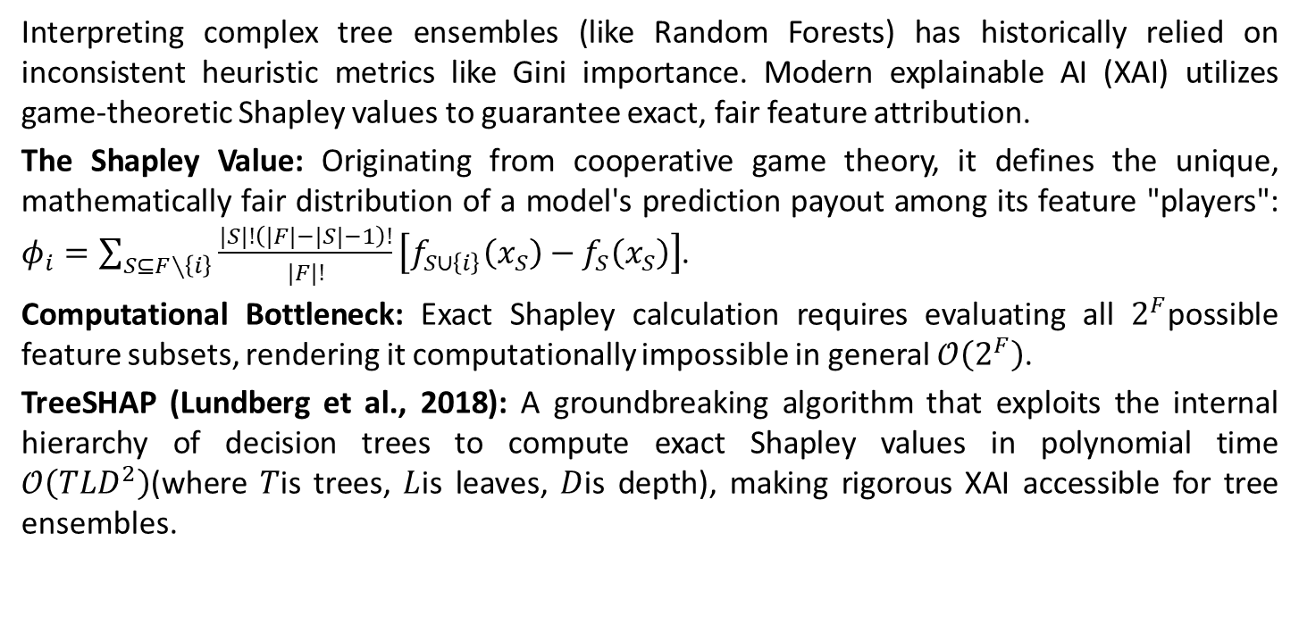
Axiomatic Feature Attribution & TreeSHAP
Interpreting complex tree ensembles (like Random Forests) has historically relied on inconsistent heuristic metrics like Gini importance. Modern explainable AI (XAI) utilizes game-theoretic Shapley values to guarantee exact, fair feature attribution.
The Shapley Value: Originating from cooperative game theory, it defines the unique, mathematically fair distribution of a model's prediction payout among its feature "players": $φ_{i}=\sum_{S⊆F∖\left\{i\right\}}{\frac{|S|!\left(|F|−|S|−1\right)!}{|F|!}}\left[f_{S∪\left\{i\right\}}\left(x_{S}\right)−f_{S}\left(x_{S}\right)\right]$.
Computational Bottleneck: Exact Shapley calculation requires evaluating all $2^{F}$possible feature subsets, rendering it computationally impossible in general $𝒪\left(2^{F}\right)$.
TreeSHAP (Lundberg et al., 2018): A groundbreaking algorithm that exploits the internal hierarchy of decision trees to compute exact Shapley values in polynomial time $𝒪\left(TLD^{2}\right)$(where $T$is trees, $L$is leaves, $D$is depth), making rigorous XAI accessible for tree ensembles.

Slide 33
Optimal Decision Trees via Mixed Integer Programming
Standard decision tree algorithms like ID3 and CART utilize greedy, top-down heuristics. They select the locally optimal split at each node without considering subsequent splits, virtually guaranteeing a sub-optimal global tree structure. Recent research leverages optimization theory to build globally optimal trees.
Mixed Integer Programming (MIP): Researchers formulate the entire tree-building process as a single mathematical optimization problem subject to integer constraints, optimizing all splits across all depths simultaneously.
Optimal Classification Trees (OCT): Formulations like OCT optimize a joint objective function that balances misclassification error and tree sparsity (complexity penalty), rather than sequentially maximizing Information Gain.
Performance Improvements: While computationally expensive during training, Optimal Decision Trees consistently achieve higher accuracy and tighter generalization than CART trees of the exact same depth, proving the severe limitations of greedy heuristics.

Slide 34
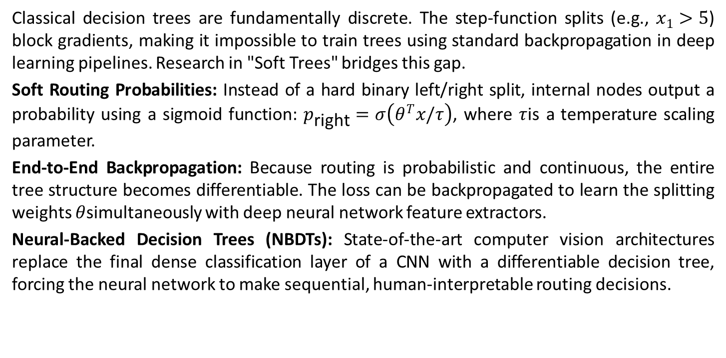
Differentiable Decision Trees & Neural Architectures
Classical decision trees are fundamentally discrete. The step-function splits (e.g., $x_{1}>5$) block gradients, making it impossible to train trees using standard backpropagation in deep learning pipelines. Research in "Soft Trees" bridges this gap.
Soft Routing Probabilities: Instead of a hard binary left/right split, internal nodes output a probability using a sigmoid function: $p_{\text{right}}=σ\left(θ^{T}x/τ\right)$, where $τ$is a temperature scaling parameter.
End-to-End Backpropagation: Because routing is probabilistic and continuous, the entire tree structure becomes differentiable. The loss can be backpropagated to learn the splitting weights $θ$simultaneously with deep neural network feature extractors.
Neural-Backed Decision Trees (NBDTs): State-of-the-art computer vision architectures replace the final dense classification layer of a CNN with a differentiable decision tree, forcing the neural network to make sequential, human-interpretable routing decisions.

Slide 35
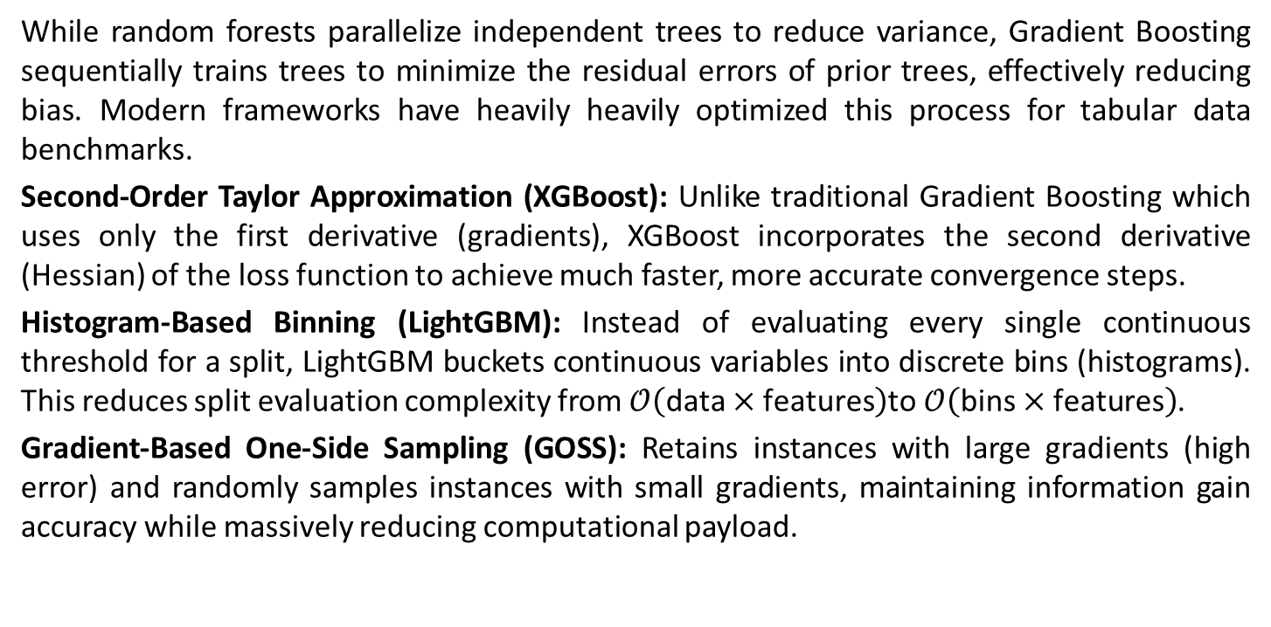
Modern Gradient Boosting Benchmarks (XGBoost & LightGBM)
While random forests parallelize independent trees to reduce variance, Gradient Boosting sequentially trains trees to minimize the residual errors of prior trees, effectively reducing bias. Modern frameworks have heavily heavily optimized this process for tabular data benchmarks.
Second-Order Taylor Approximation (XGBoost): Unlike traditional Gradient Boosting which uses only the first derivative (gradients), XGBoost incorporates the second derivative (Hessian) of the loss function to achieve much faster, more accurate convergence steps.
Histogram-Based Binning (LightGBM): Instead of evaluating every single continuous threshold for a split, LightGBM buckets continuous variables into discrete bins (histograms). This reduces split evaluation complexity from $𝒪\left(\text{data}×\text{features}\right)$to $𝒪\left(\text{bins}×\text{features}\right)$.
Gradient-Based One-Side Sampling (GOSS): Retains instances with large gradients (high error) and randomly samples instances with small gradients, maintaining information gain accuracy while massively reducing computational payload.

Slide 36
Causal Forests & Asymptotic Honesty
Standard Random Forests are purely predictive. When researchers need to measure Heterogeneous Treatment Effects (HTE)—such as predicting how much a specific patient's blood pressure will drop if given a drug vs a placebo—they turn to Causal Forests (Athey & Wager).
Heterogeneous Treatment Effects (HTE): Adapts the splitting criterion to maximize the difference in treatment effects between the left and right child nodes, isolating sub-populations that react uniquely to interventions.
Asymptotic Honesty: A critical theoretical requirement. The data used to determine the tree's split structure must be strictly separated from the data used to estimate the leaf node values. If the same data is used for both, the estimates become statistically biased.
Sub-sampling for Normality: Causal Forests eschew standard bootstrap aggregating (bagging with replacement) in favor of sub-sampling without replacement. This mathematical constraint guarantees that the forest's predictions converge to a Gaussian distribution, enabling the calculation of rigorous confidence intervals.

Slide 37
Code for Decision Tree
Theory Related Code: https://colab.research.google.com/drive/17exsFq6ZRIMT-WTgwJKVdtyQvYyY1ilK?usp=sharing
Implementation Code: https://colab.research.google.com/drive/18fD_F7z9Vp7nm-1Q5vjgZZ7HpGjQdnOL?usp=sharing

